Slide 1

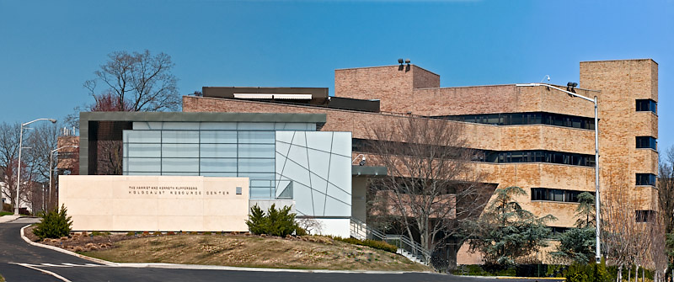


Slide 2
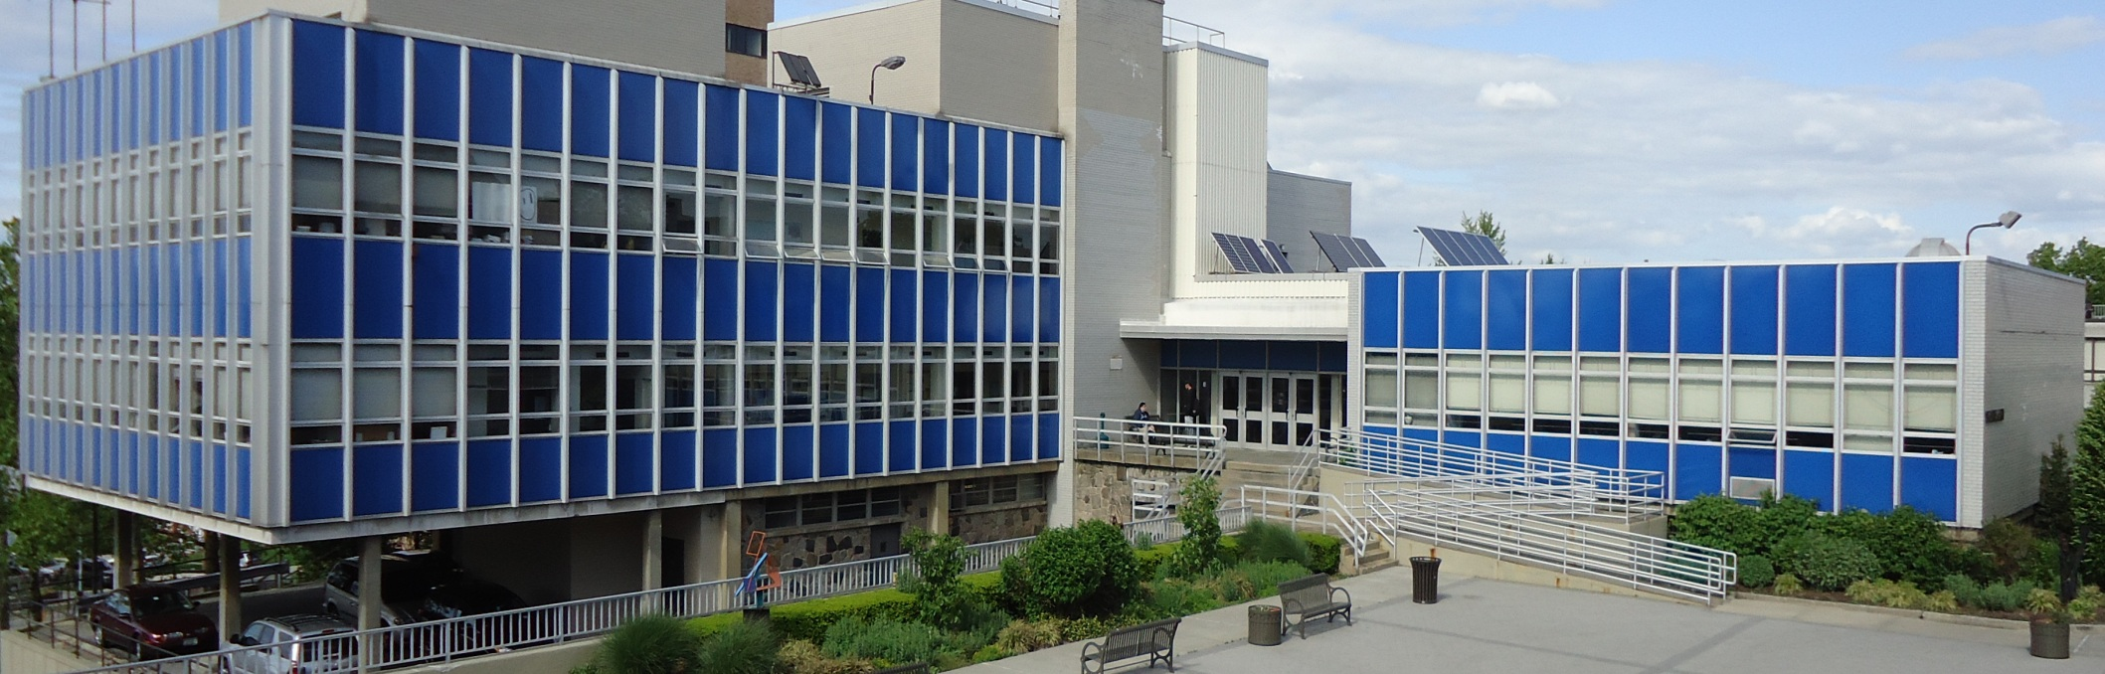
QueensBorough Community College Department of Engineering Technology

Slide 3


engineering Technology department Programs
A.A.S Computerized Architectural and Industrial Design
A.A.S. Computer Engineering Technology
A.A.S. Electronic Engineering Technology
A.A.S. Mechanical Engineering Technology
A.A.S. Internet Technology
A.A.S. Telecommunications Technology
Verizon Next Step
A.S. Engineering Science

Slide 4

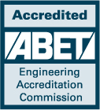
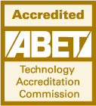

A.A.S. Computer Engineering Technology
A.A.S. Electronic Engineering Technology
A.A.S. Mechanical Engineering Technology

Slide 5
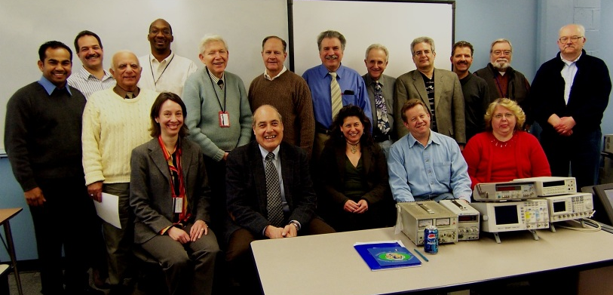
Engineering Technology Department Staff

Slide 6
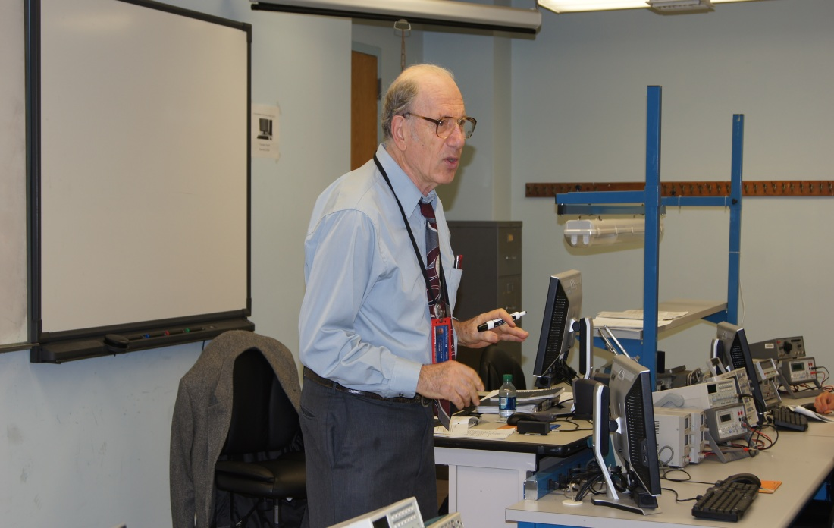
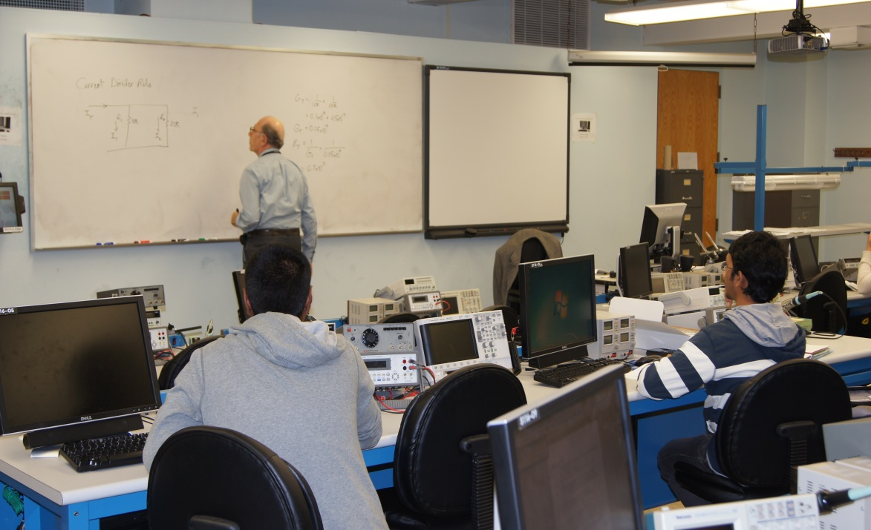
21 full-time faculty members
Credentialed with
Ph. D's, PE Licenses...
and many years of
Industrial Engineering Experience

Slide 7
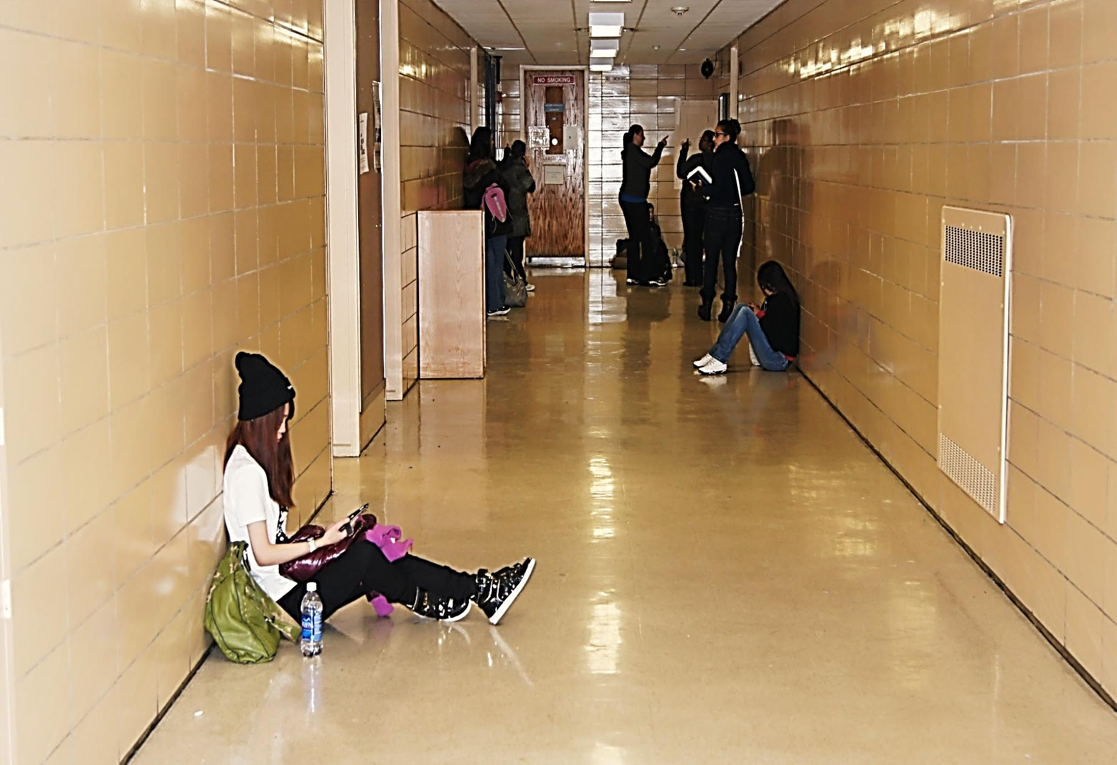
Engineering Technology Educational Objectives
Career Preparation and Advancement – Graduates will demonstrate mastery of the knowledge and skills needed for entry into or advancement in an engineering technology field of study.
Engineering Competence - Graduates will be competent technicians with problem solving and design skills, and have the ability to apply mathematics and science to solve engineering technology problems.
Professional Skills - Graduates will have strong communication skills, and the ability to work successfully in teams.
College Transfer - Graduates will meet the requirements for transfer into the junior year of a baccalaureate program in engineering technology

Slide 8
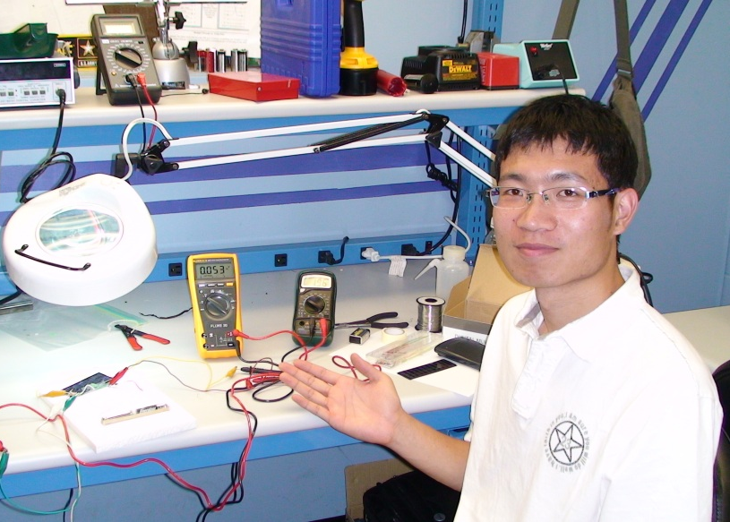
The mission of the Engineering Technology Program at Queensborough Community College is to develop technically competent and professional graduates for successful careers within the profession.

Slide 9
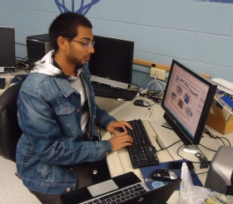
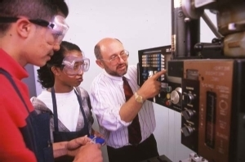
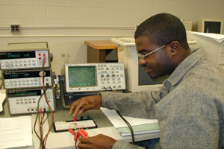
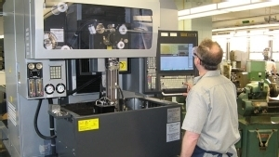
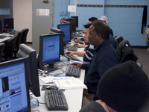
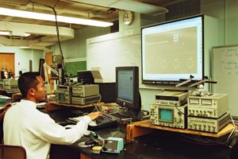
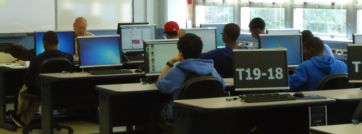
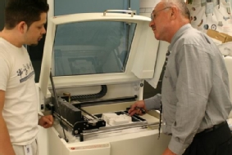
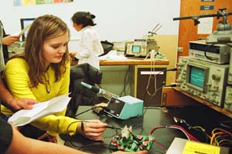
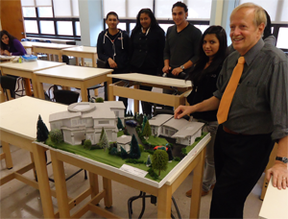
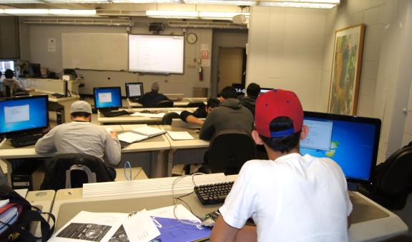
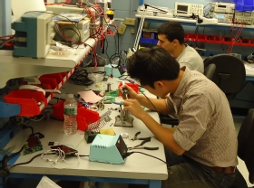
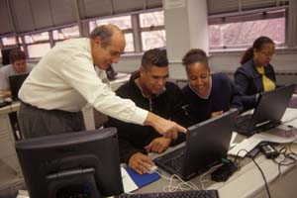
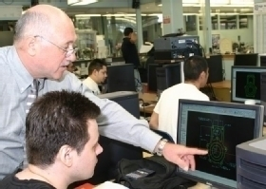
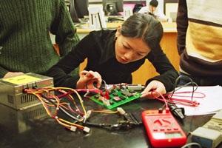
16 Labs Across Multiple Disciplines
The Engineering Technology Department maintains sixteen modern laboratories, fitted with state-of-the-art equipment in support of multiple disciplines.

Slide 10
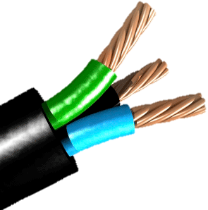

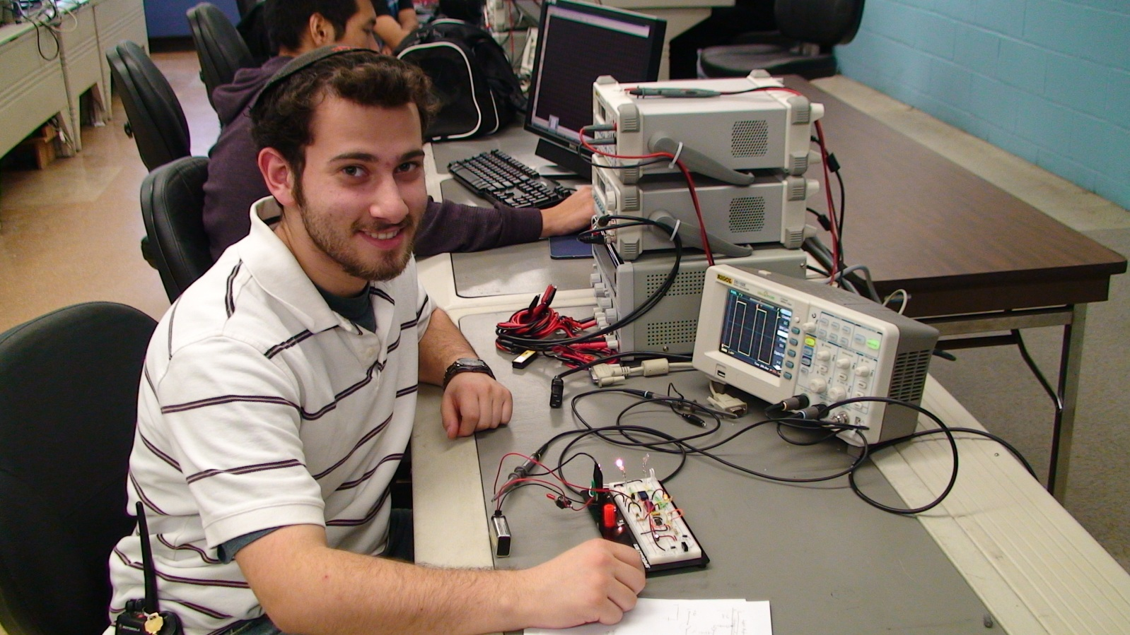
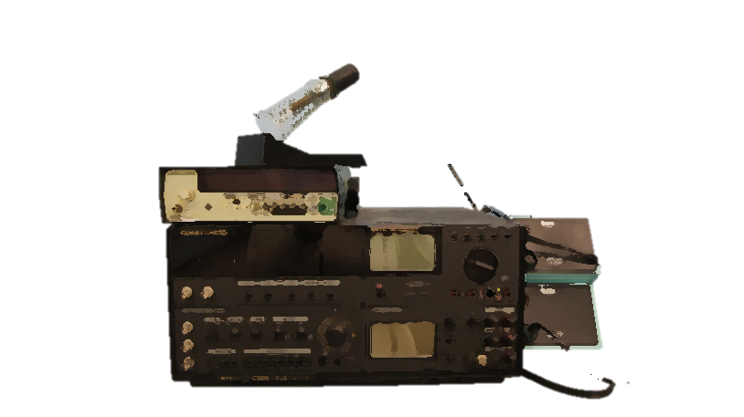
Electric Circuit Analysis I
ET-110 train’s students in the application of Ohm’s Law, Kirchhoff’s Law, Thevein’s &Norton’s Theorems, and superposition to the analysis of dc & ac circuits , including R-L-C circuits, impedances, phase angles, resonance and transformers.

Slide 11
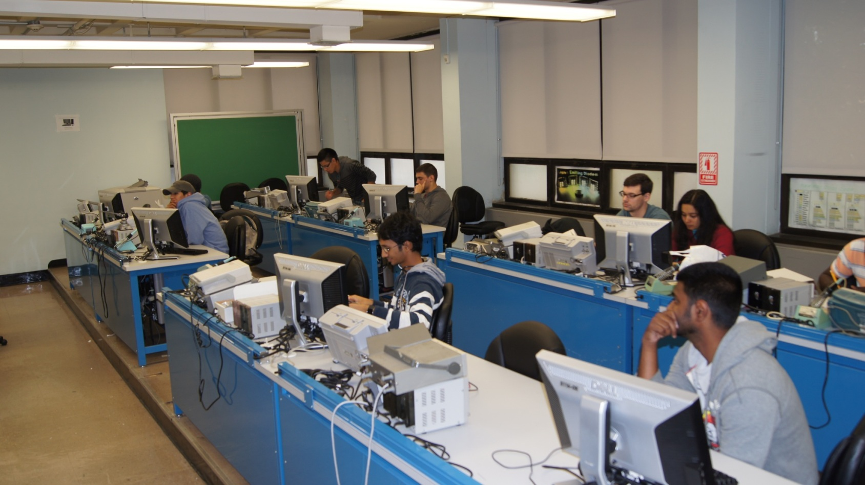
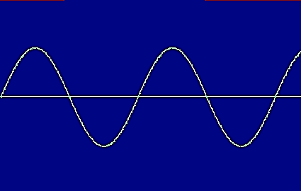
Sinusoidal and Transient Circuit Analysis
ET-140 Students are introduced to Sinusoidal waveforms; impedance, phasor quantities, AC meters; passive filters; initial conditions, transients in RC and RL circuits.
Laboratory hours complement class work

Slide 12
Electronics I
ET-210 Basic theory and operation of solid-state devices including diodes, BJTs, FETs, and MOSFETs, silicon-controlled rectifiers, varactors and Zener diodes. Clipping and clamping circuits. Graphical and equivalent circuit analysis of active devices. DC biasing and AC analysis of transistor circuits. Rectifiers, filter and power supply circuit design. Laboratory hours complement class work.

Slide 13


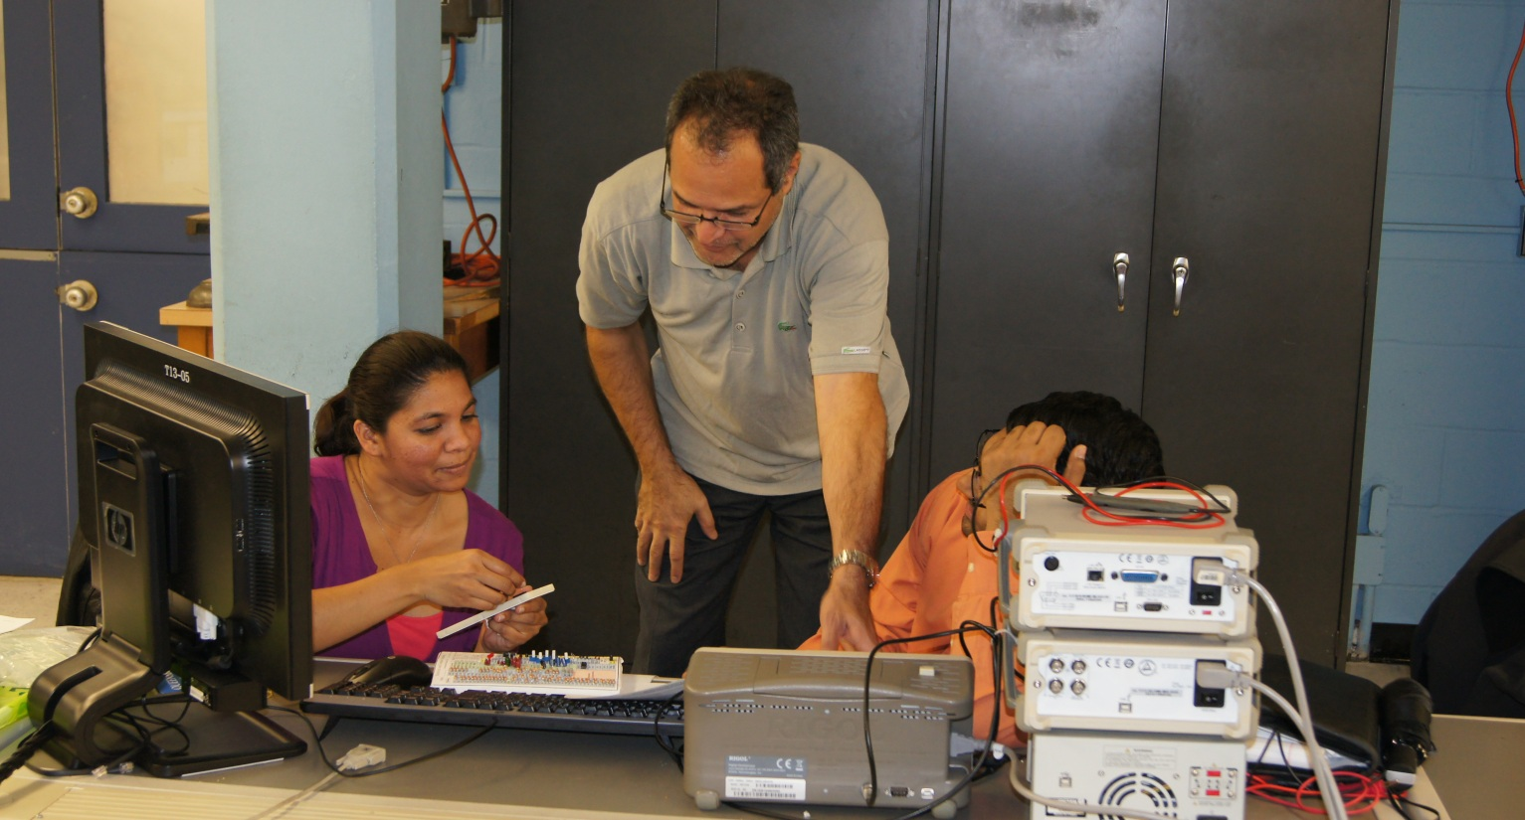
Electronics II
ET-220 shows students how to design small and large signal amplifiers (transistor, FET); frequency response of amplifiers; D.C. amplifiers, operational amplifier circuits; integrated circuit theory; regulated transistor power supplies. Laboratory hours complement class work.

Slide 14
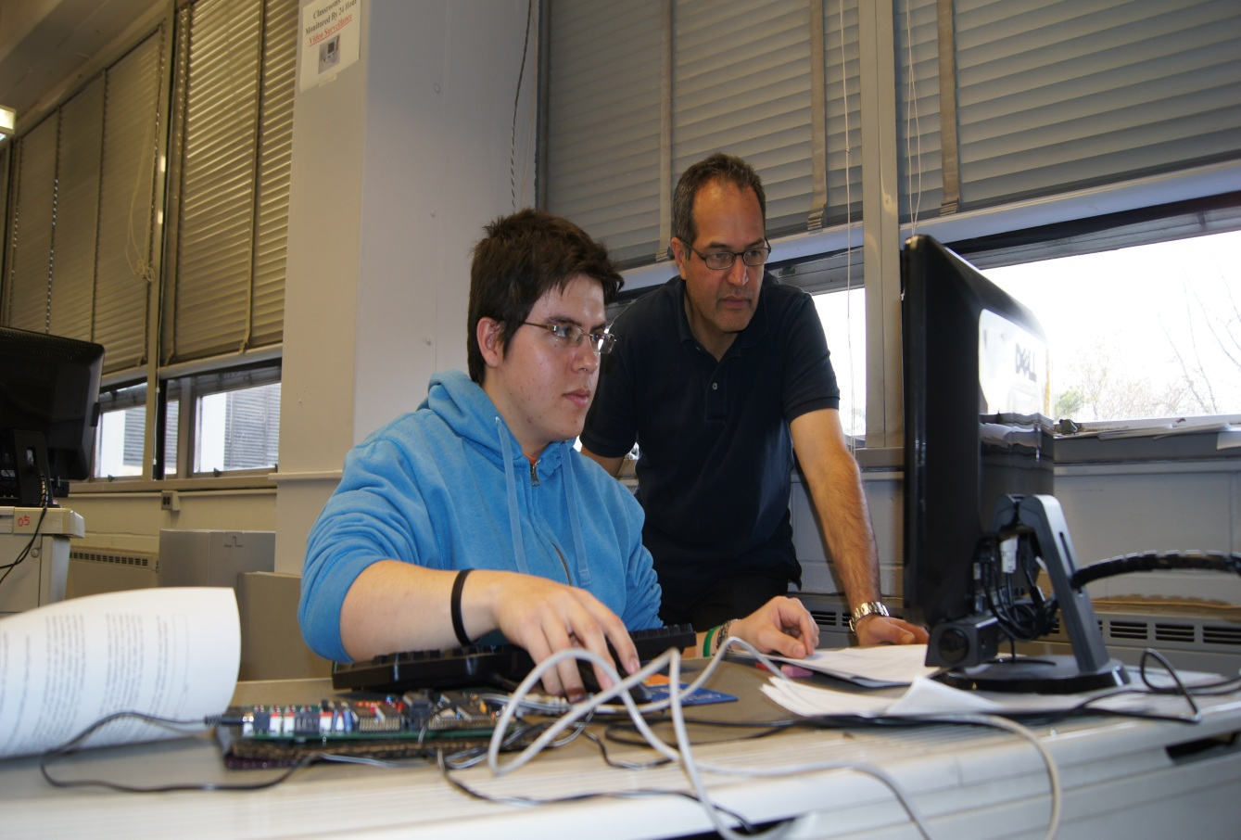
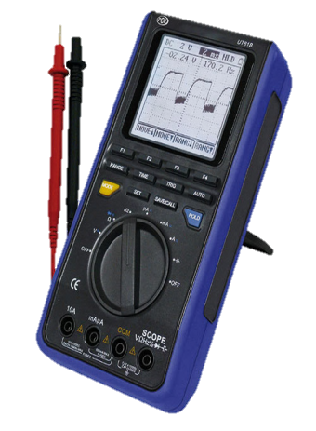
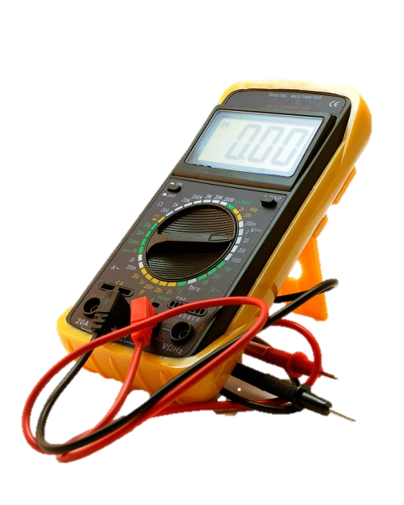
ET-510 Number systems; memory elements; logic elements; timing elements; digital computer logic circuits; Laboratory hours complement class work.
Introduction to Digital Electronics

Slide 15
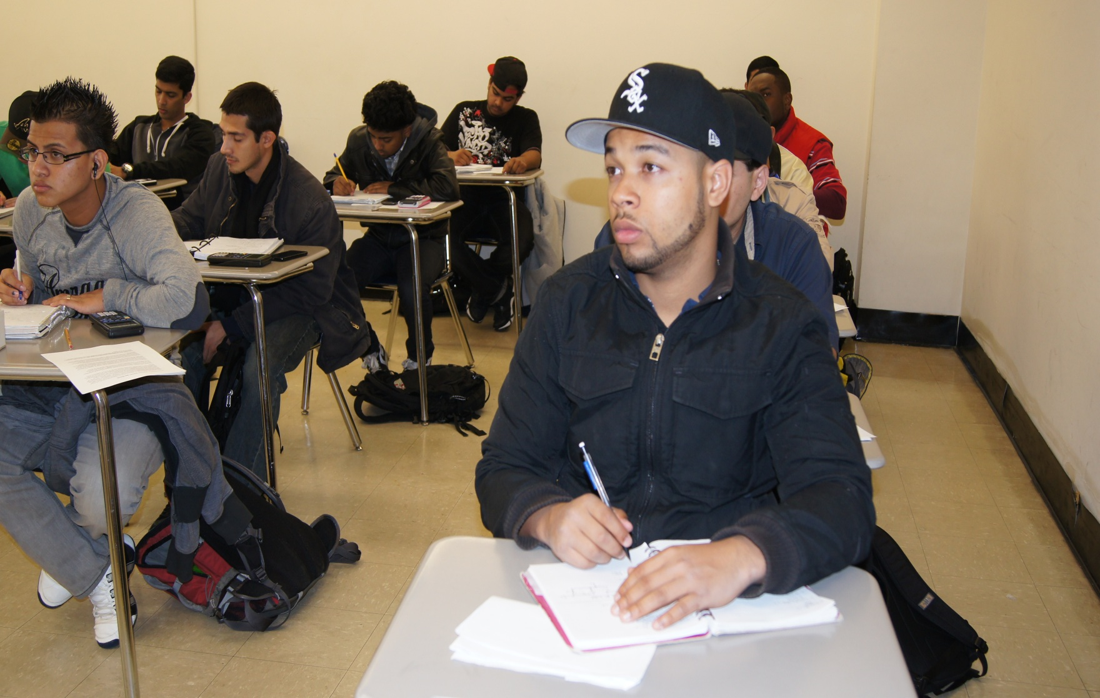
Digital Computer Theory I
ET-540 number systems; Boolean algebra; logic elements; multivibrators; clock circuits; decoders; counters; data registers. Laboratory hours complement class work.

Slide 16
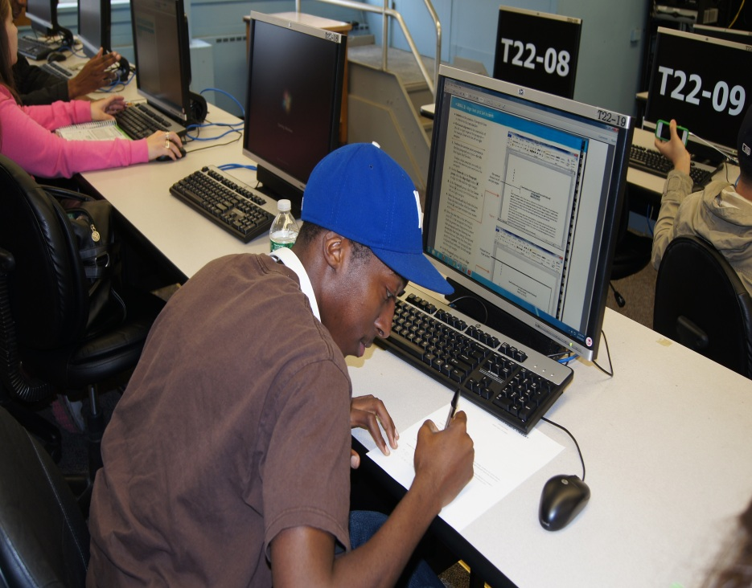
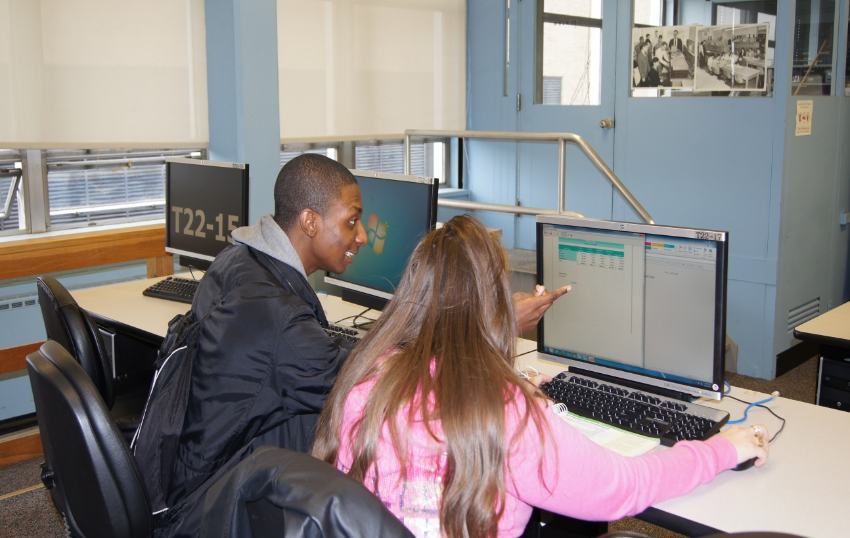
PC ESSENTIALS 1
ET- 531 is designed to train students in the organization, architecture, setup, maintenance, hardware and software aspects of local area networks.

Slide 17
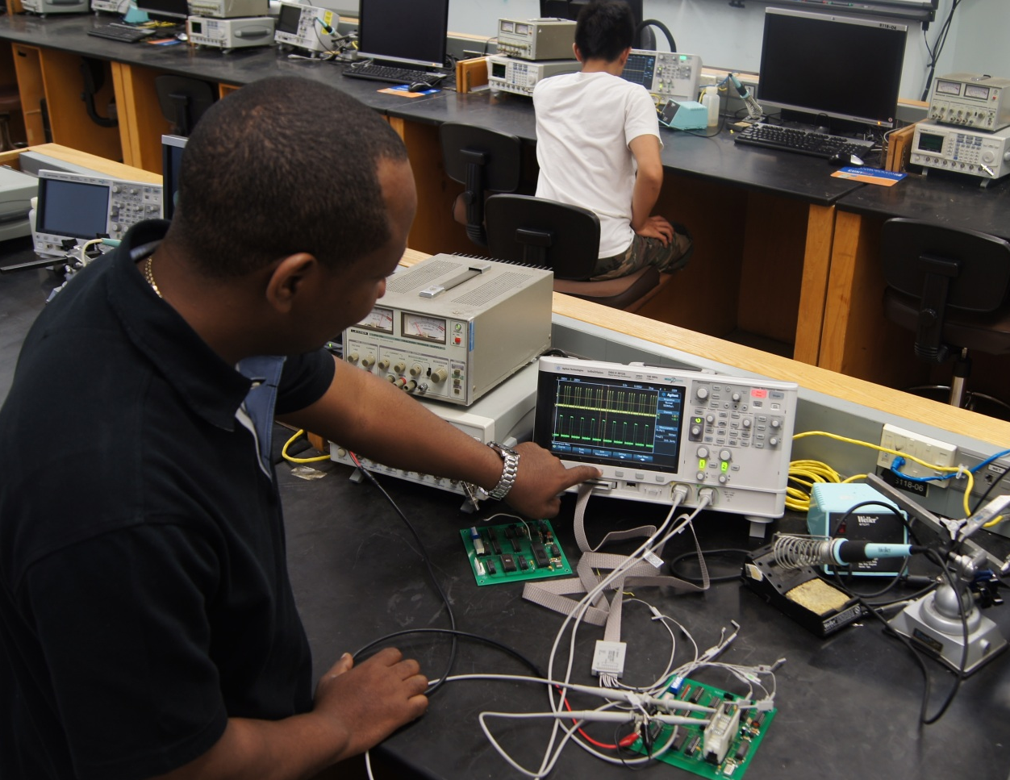
Microprocessors and Microcomputers
ET-560
Study of microprocessor and microcomputer systems.
Topics include: microprocessor architecture,
memory interfacing,
I/O systems, interrupt processing, microprocessor communications, and microcomputer peripherals.
Laboratory hours complement class work.

Slide 18

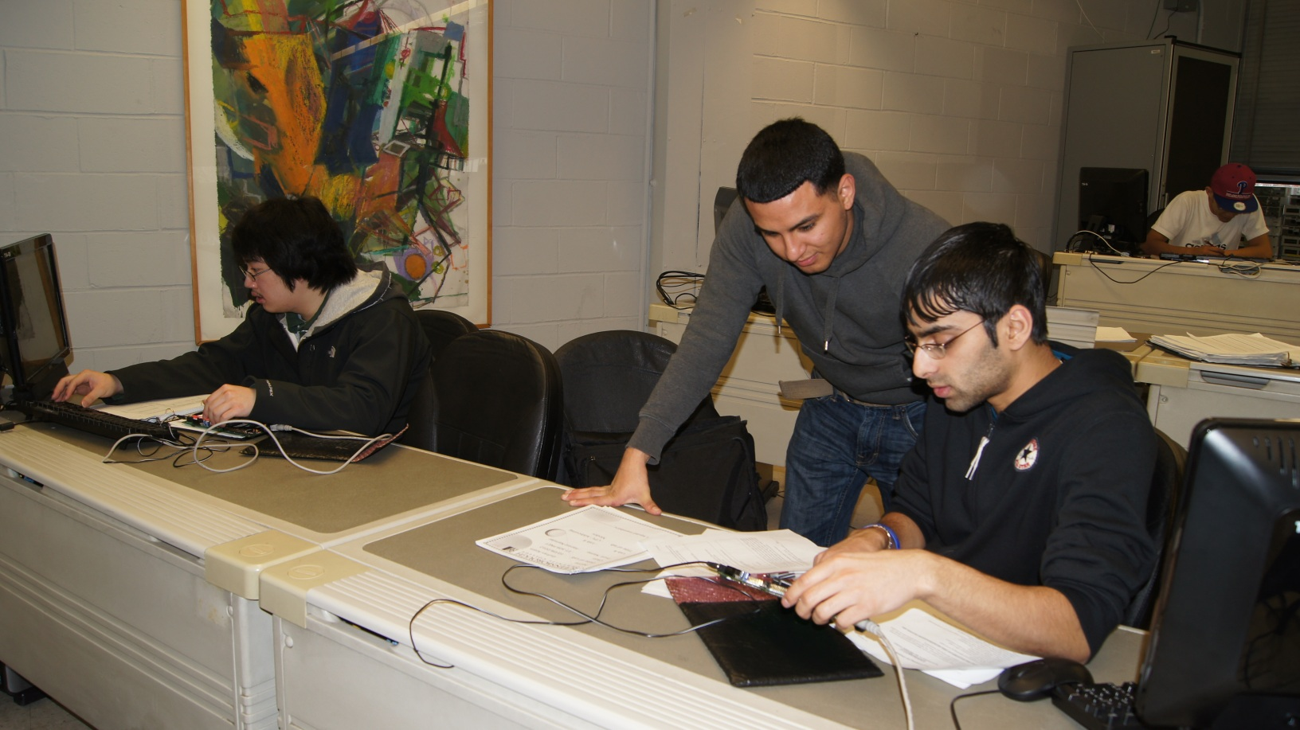
C++ Programming for Embedded Systems
ET-509 The nature of a program, simple C++ programs, variables, binary and hex number system, mathematical and logic operations with binary and hex numbers, looping and delays, arrays, pointers, microprocessor memory characteristics, data manipulation using pointers, input /output programming exercises on a real microprocessor.

Slide 19
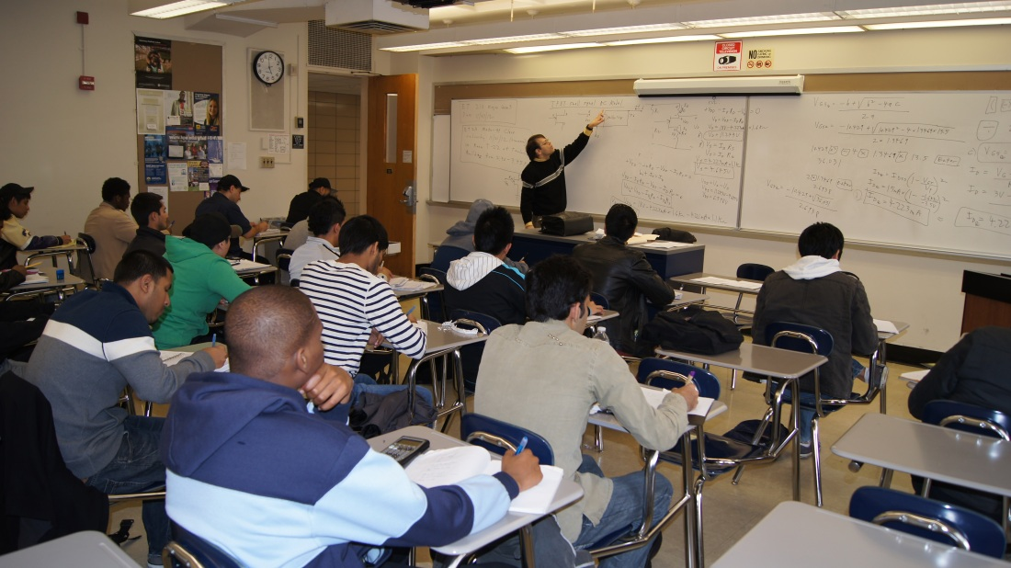
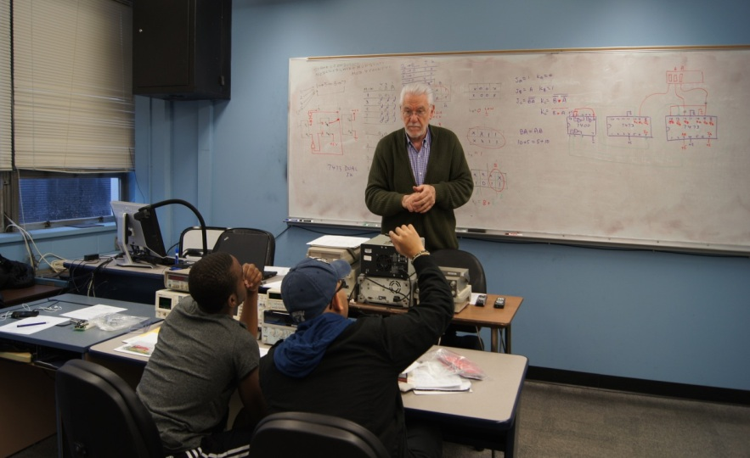
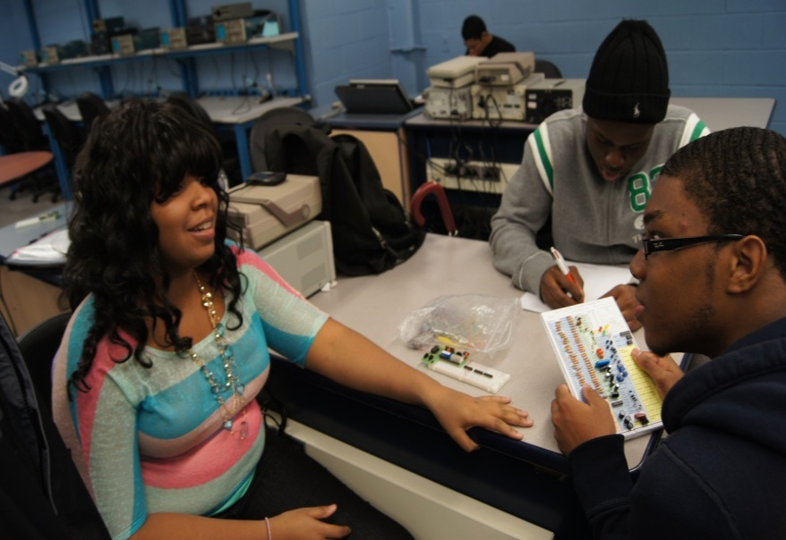
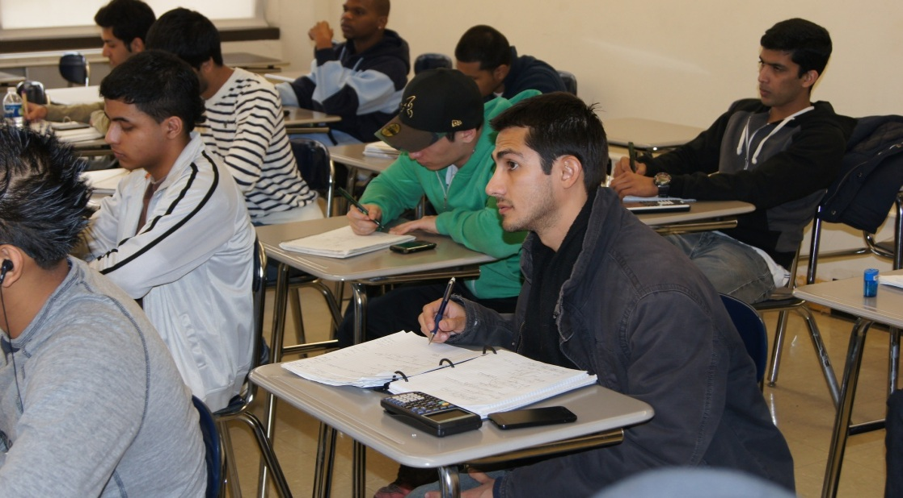
Telecommunications I
ET230 - The theory and principles of modern electronic telecommunications devices, including telephones, digital and optical communications links, radio, television, and radar. Laboratory hours complement class work.

Slide 20
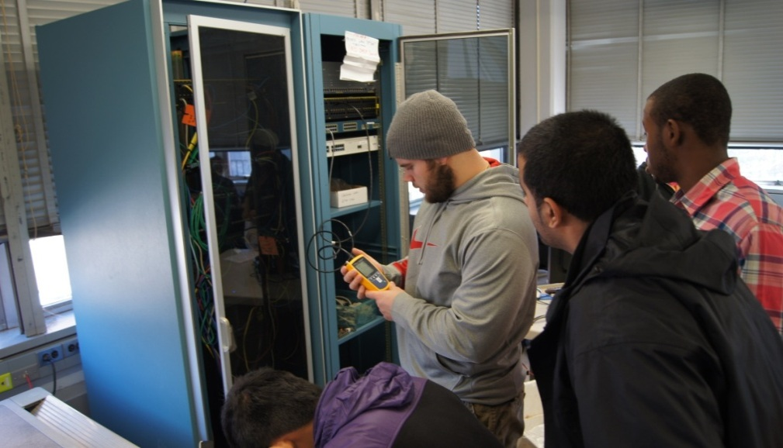
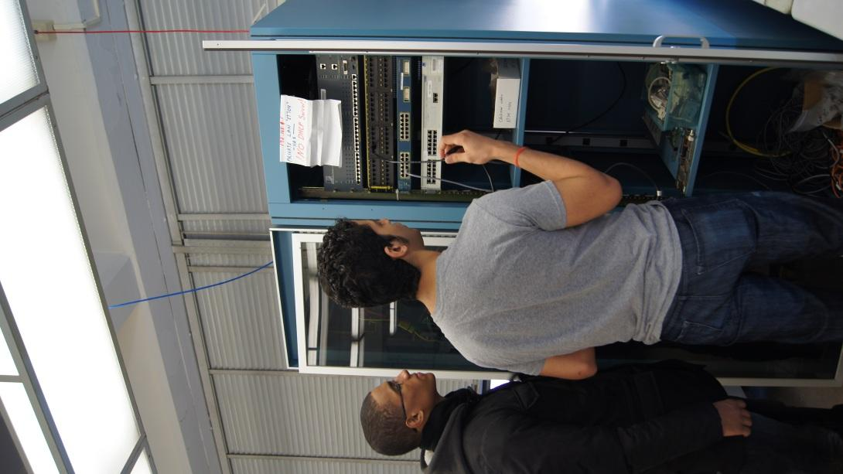
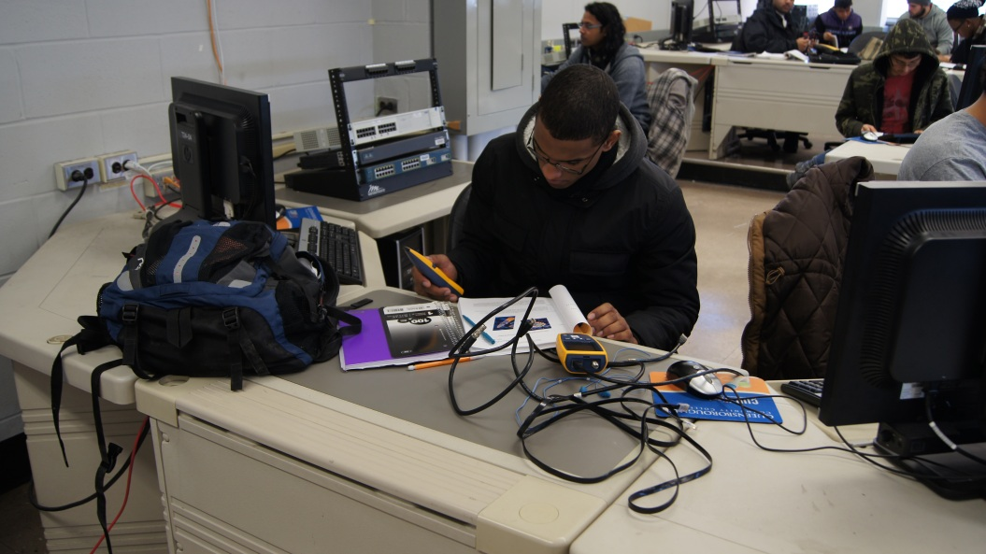
Networking Fundamentals I
ET -704 An introductory level course that provides students with the basic terminology and skills needed to design, build and maintain small to medium networks.

Slide 21
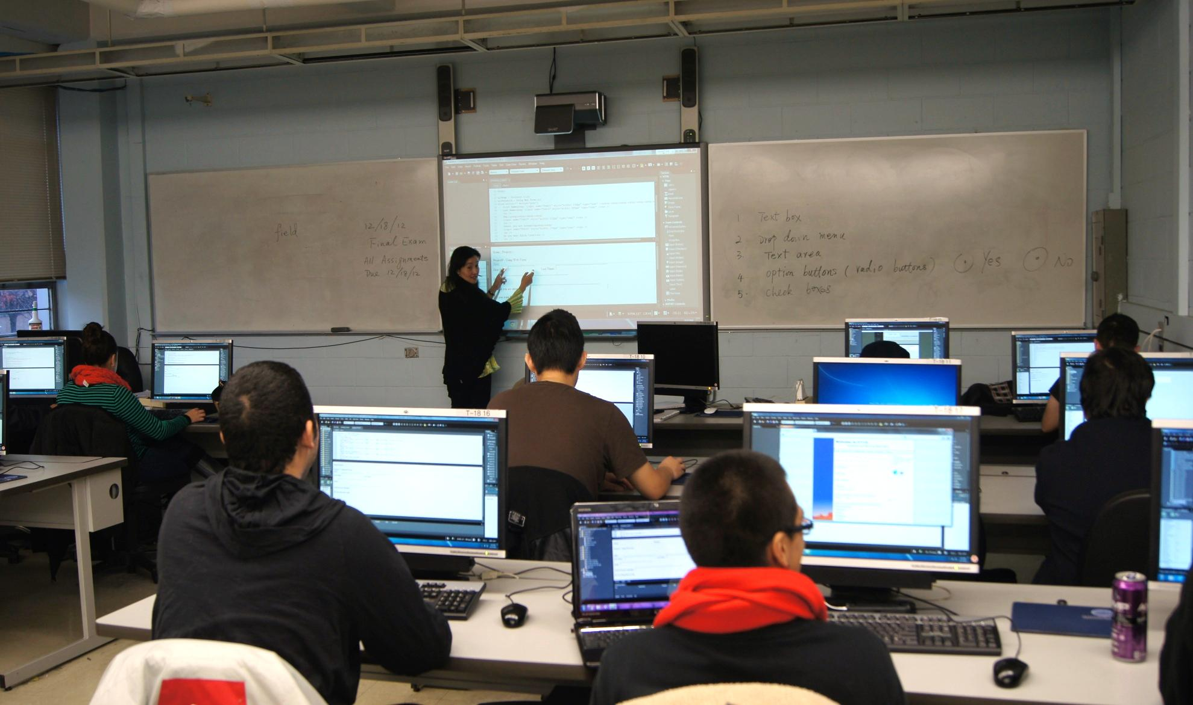
Web Technology 1
ET-710 Students learn to design, build and administer their own World Wide Web site. The course covers everything from Web Server installation to the preparation of multimedia content for delivery on the Internet/Intranet.

Slide 22
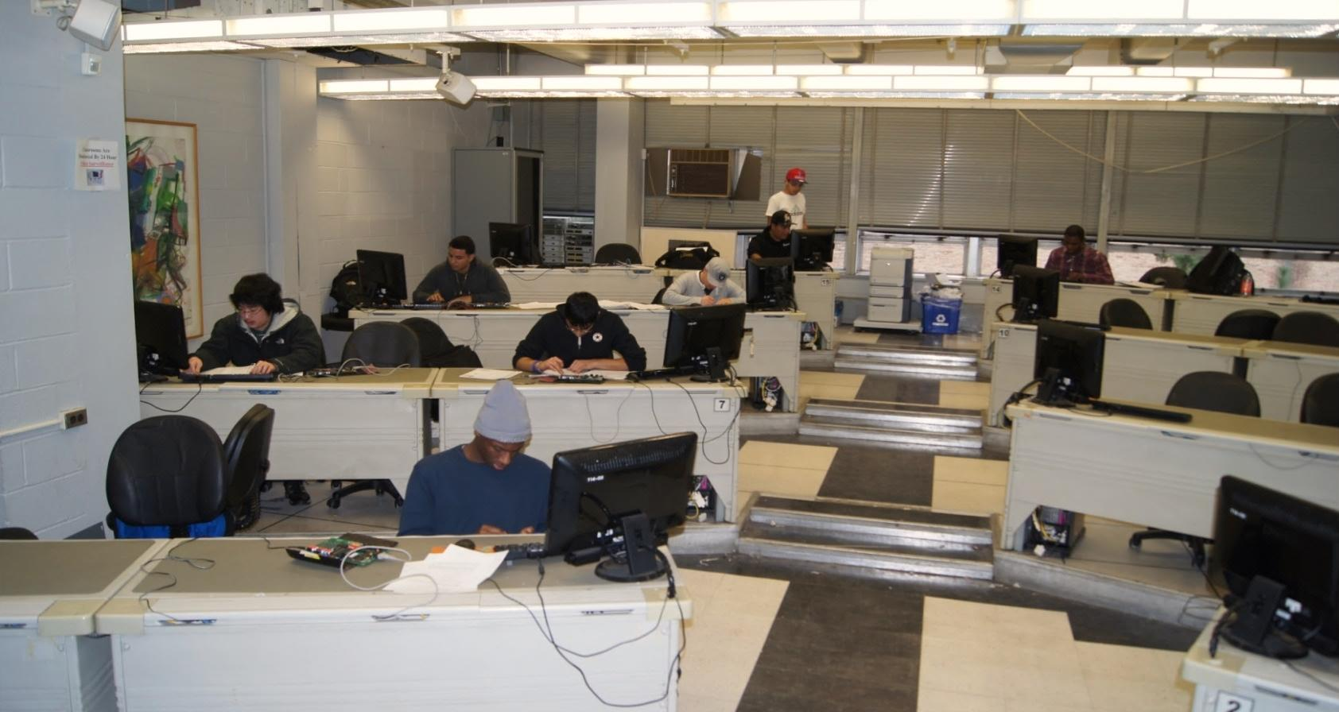
Database Technology
ET -718 Students will learn the fundamentals of modern database technology.
They will study and create solutions using Enterprise database technology such as
Microsoft SQL Server. Topics include: database integrity, consistency and
security; database replication planning and deployment; publishing database data on the Web

Slide 23
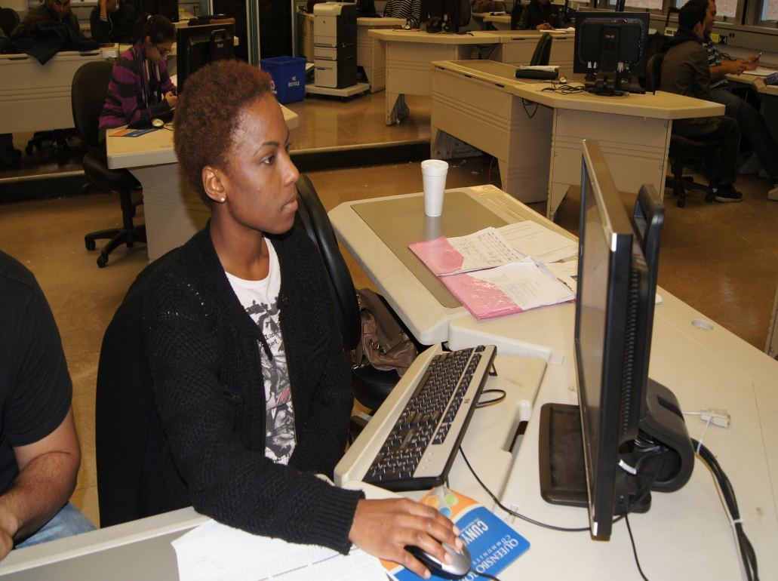
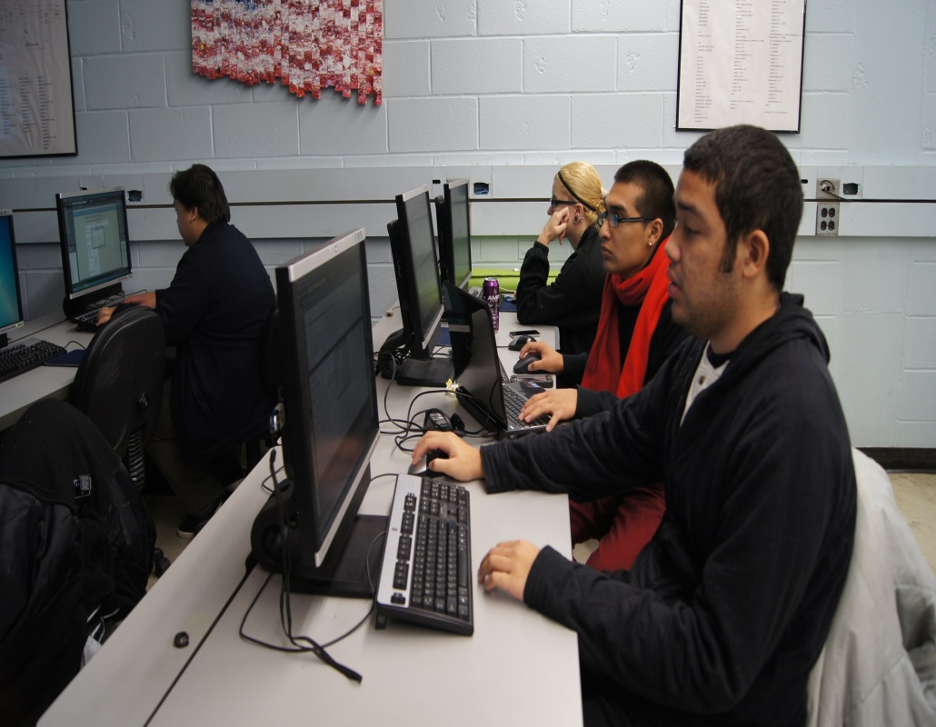
Web Technology: XML
ET-728
Students will learn some of the advanced data base techniques behind today's Business to Business (B2B) Web sites, as well as advanced Web server programming techniques that make Business to Consumer (B2C) work. Students will study and create solutions using extensible Markup Language tools.

Slide 24
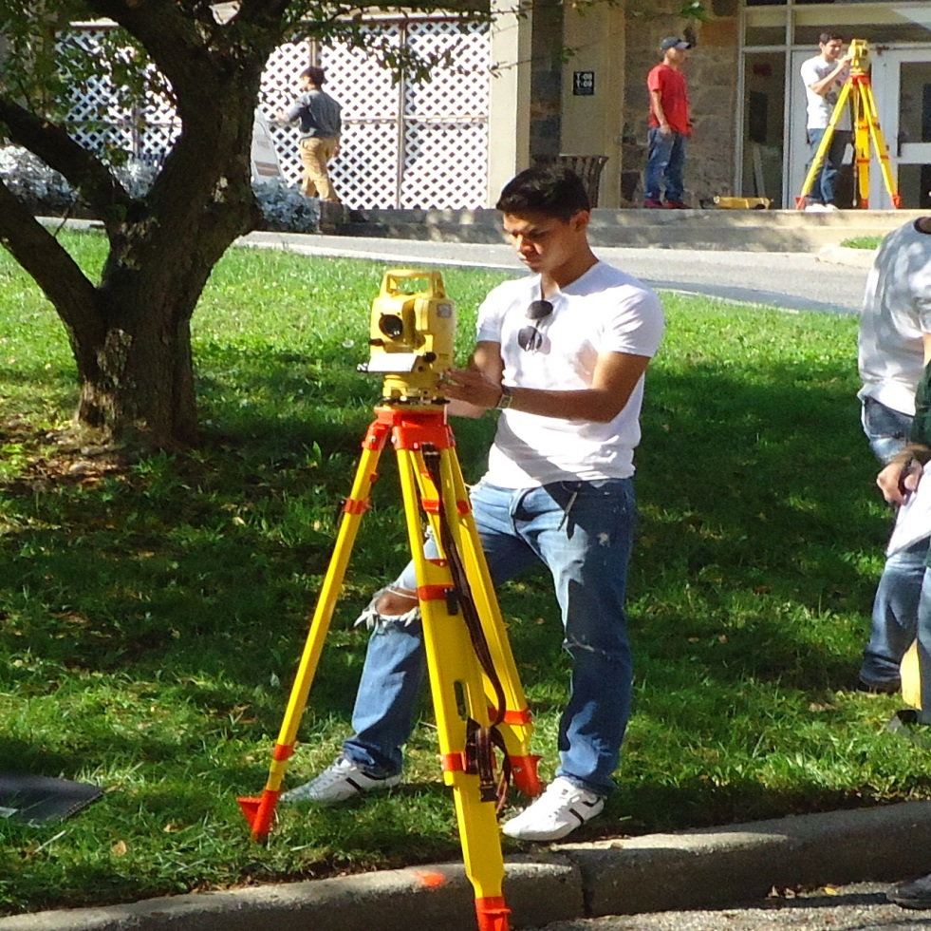


Surveying and Layout
MT-219 Use, adjustment, and care of surveying instruments. Field work in practical application of surveying techniques; measurement of distances, angles, and elevations. Computation and mapping of closed traverses.

Slide 25




Architectural Design Fundamentals
MT-481 Introduction to architectural drawing presentation; plan, elevation, section, detail, perspective, and model-making. Development of preliminary working drawings. Understanding of basic architectural design concepts.

Slide 26




Technical Graphics
MT-111 Introduction to the theory and practice of basic engineering drawing. Use of drafting instruments, geometric constructions, lettering, multi-view projection, isometric and oblique drawings. Sectional and auxiliary views. Principles of dimensioning

Slide 27




Computer-Aided Design I
MT-488 Introduces students to the use of computer hardware and software for design drafting.
Students generate working drawings

Slide 28

Manufacturing Processes
MT- 122 Production techniques in manufacturing, including introduction to materials, gauging, machining, welding, casting and molding, forming and finishing processes. Laboratory practice in the use of hand tools, machine tools, and precision-measuring instruments.

Slide 29




Metallurgy
and Materials
MT-124 General properties and applications of metals, polymers, concrete and wood. Solidification of pure and alloyed metals. Fundamentals of the Fe-C system. Principles of heat treating. Stainless steels. Corrosion.

Slide 30



Introduction to Robotics
ET-375 This course is designed to introduce robotic construction, programming, operation and basic theory to the students. Students will construct and test microcontroller based robots in the laboratory.

Slide 31




Personal Computer Technology,
Architecture and Troubleshooting
ET-481 Essential concepts in PC architecture, application via this hands-on course in modern PC computing technology. This course covers the hardware and software concepts for CompTIA A+ Certification.

Slide 32

Electrical Circuits
EE-204 Circuit elements and their voltage-current relations; Kirchoff's laws' elementary circuit analysis; continuous signals; differential equations; state variable equations; first and second order systems; introduction to circuit analysis software.

Slide 33



Tau Alpha Pi Honor Society

Slide 34




Engineering Technology Department
Gaming Club

Slide 35

Graduating engineering technicians are widely sought after by industry and employed in such diverse positions as
t computer technician
t technical sales representative
t electrical designer
t electronic technician
t research technician
t technical writer
t and field or customer engineer.
After Graduation

Slide 36

Queens, The Most Diverse County In America*
Queensborough Community College students reflect that diversity and will be among tomorrow's leaders.
*2001 Claritas Diversity Study of counties with populations over 100,000

